Slide 1


Python Coding Session File Handling
Introduction to Implementation Details and Usage

Slide 2

Introduction
File handling in Python refers to the process of reading from and writing to files on your computer's storage. Python provides built-in functions and methods to interact with files easily. We will be covering the txt, CSV and JSON files

Slide 3
Python File Handling

Slide 4
Process of Reading a File

Slide 5
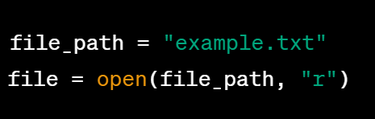
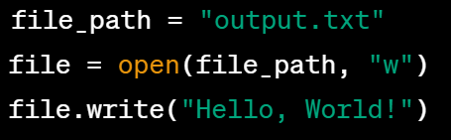
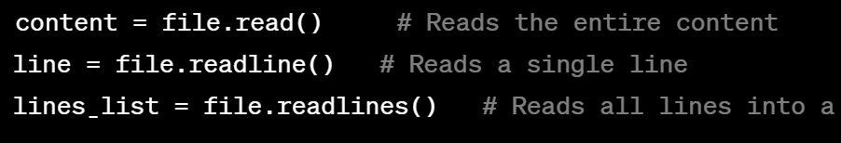

Most used operations
Writing on txt file
Opening txt file
Reading the file content
Closing file

Slide 6
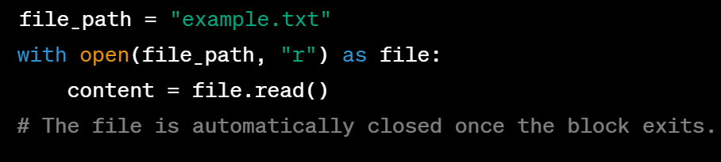
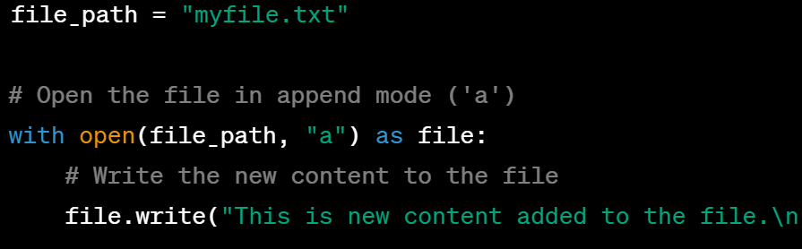
“with” Statement

Slide 7
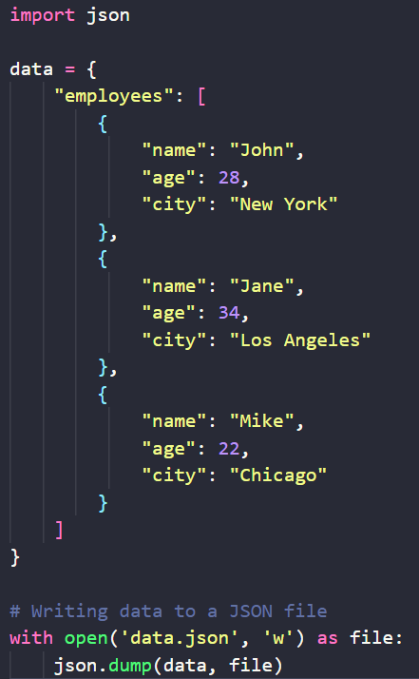
JSON files

Slide 8
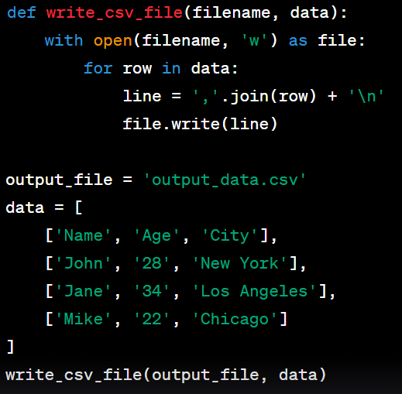
CSV files

Slide 9
Exercises
Exercise 1: Read and Print File Contents Write a Python program that reads a text file named "data.txt" and prints its content to the console.
Exercise 2: Append to a File Write a Python program that prompts the user to enter a sentence and then appends that sentence to a file named "output.txt" without overwriting its existing content.
Exercise 3: Count Lines in a File Write a Python program that reads a text file named "text.txt" and counts the number of lines in the file. Print the total count to the console. Exercise 4: Create a CSV file named "students.csv" with columns "Name" and "Score" for three students.
Exercise 5: Create a JSON file named "movies.json" with information about three movies, each having "Title", "Genre", and "Year" properties.

